Slide 1










Predicting Obesity Level using Machine Learning Models: Random Forest, XGBoost and LightGBM
Nicholas Farandi Harjanto - 2602065553
Bryan Orville Audric - 2602160750
Edrico Putra Pramana - 2602078133
Darren King Wijaya - 2602145232

Slide 2

List
of
Contents
Introduction
Dataset
Research Flow
Feature Engineering
Machine Learning Model
Evaluation Metrics
Results
Discussion
Impacts
Conclusion

Slide 3
Introduction
What is obesity?
Obesity is a medical condition characterized by an excessive accumulation of body fat that presents a risk to health such as cardiovascular disease, diabetes, reducing life expectancy and causing disability.
Importance of identifying cause of obesity
Understanding obesity causes is vital for prevention and management. Tailored interventions based on accurate identification improve weight management, reduce health risks, and enhance overall health through personalized treatment plans.
Objective of this research
to create an accurate obesity level detector using machine learning models such as Random Forest, XGBoost and LightGBM

Slide 4
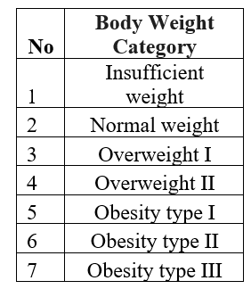
Labels
Dataset
Details
The dataset contains 20751 data which consist of 16 features and 7 labels

Slide 5
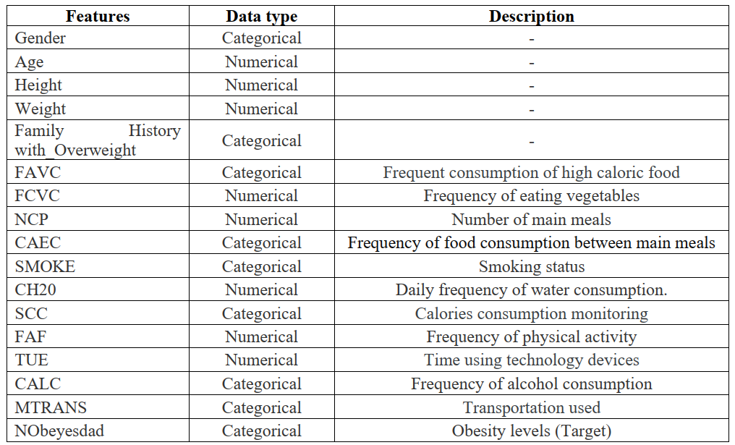
Dataset
Features

Slide 6
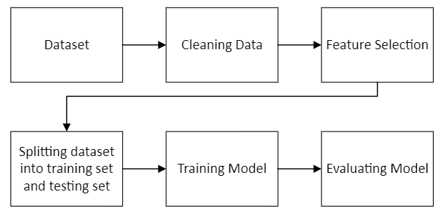
Research Flow

Slide 7
Cleaning Data, Feature Selection
The dataset is cleaned by removing outlier and data with null values
Pearson Correlation is implemented to help select most relevant features, by calculating every feature’s correlation coefficient

Slide 8
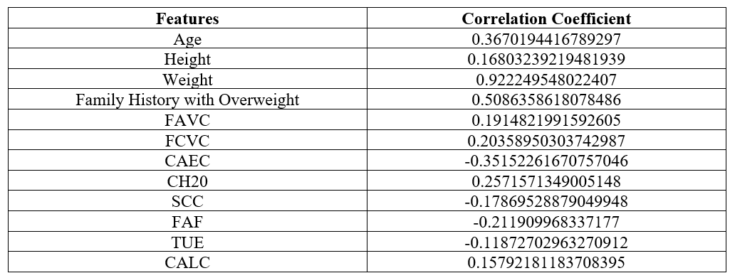
Selected Features
The features of the dataset will be selected if it has an absolute correlation coefficient above 0.1

Slide 9
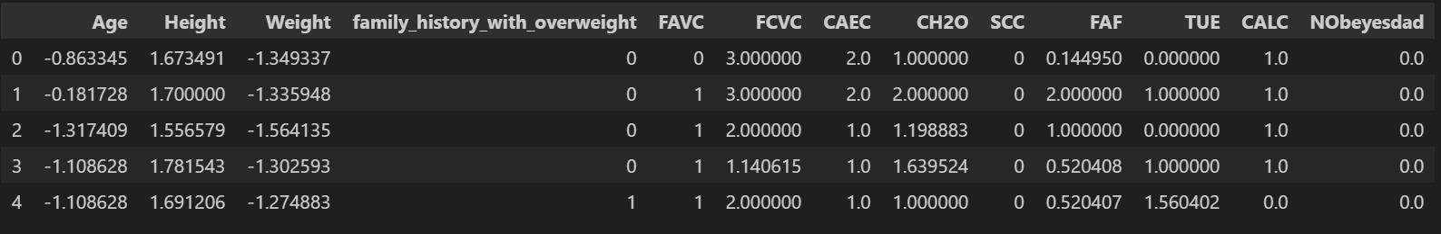
Standardizing Age And Weight

Slide 10
Splitting Dataset into testing set and training set
The dataset is divided with a ratio of 80% for training set and 20% for testing set

Slide 11
Machine Learning Models
Random Forest
Random Forest combines random decision trees to avoid overfitting. Each tree votes on the outcome, enhancing accuracy.
XGBoost
LightGBM
XGBoost is an efficient tree boosting system that minimizes errors, prevents overfitting, and scales to large datasets effectively.
LightGBM is an Advanced GBDT with techniques like GOSS and EFB for optimized training and efficiency. Accelerates model training, reduces memory usage, and maintains high accuracy, ideal for large datasets in ML tasks.

Slide 12
Evaluation
Metrics
Accuracy
Recall Score
Accuracy assesses a model's overall classification correctness. It's calculated by dividing correct predictions by total predictions.
Recall, or sensitivity, is crucial in classification, especially for capturing all positives. It measures the model's ability to identify positives correctly, calculated as true positives divided by all actual positives.
Precision
F1 Score
Precision is vital in classification, especially for minimizing false positives. It measures accurate positive predictions, calculated by dividing correctly predicted positives by all predicted positives.
Recall, crucial in classification, captures all positives. It's true positives divided by all actual positives.

Slide 13
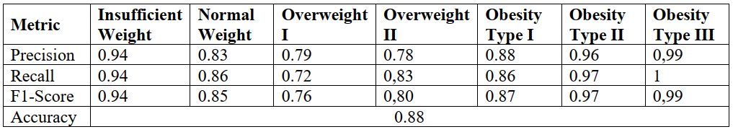
Results
Random Forest

Slide 14
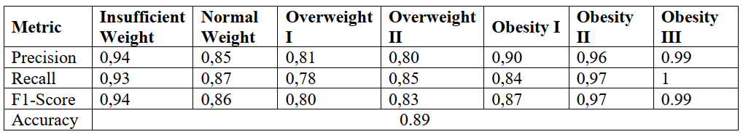
Results
XGBoost

Slide 15
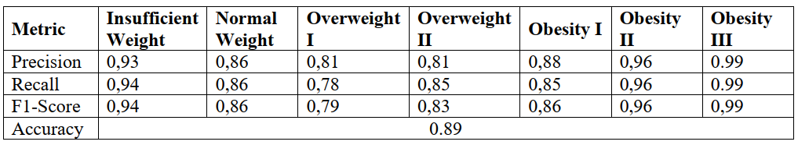
Results
LightGBM

Slide 16
Discussion
Both XGBoost and LightGBM achieved an accuracy of 89% higher than Random Forest.
When predicting the categories “Insufficient Weight”, “Obesity II”, and “Obesity III” has the highest Precision, Recall, and F1-Score, the models are much more consistent at detecting the outside classes instead of the classes in between

Slide 17
Impact in Real Life Setting
Some features such as frequency of vegetable consumption (FCVC) and other lifestyle-related data require detailed personal information, which may be an inconvenience for some to gather.
However, the information needed is still feasible to be obtained easily. If the information is collected and given to the models, it can be preventive measure to detect early signs of obesity before making a further consultation with the doctor

Slide 18
Conclusion
Both XGBoost and LightGBM achieved the highest accuracy of 89% amongst three machine learning models used
By collecting several data such as frequency of vegetable consumption (FCVC) and other lifestyle-related data, the model can use the data to detect early sign of obesity

Slide 19
Future Direction
Future research could go deeper on finding more accurate model as well as finetuning our method to further increase the performance in determining the classification of obesity level
Other ideas might be to collaborate with biology or healthcare professionals to create tools that can automatically collect parameters such as frequency of vegetable consumption (FCVC) and other lifestyle-related data, which can be used for the models to detect early sign of obesity

Slide 20
Thank you for your attention

